Slide 1
Comprehensive Digital marketing project work on Wipro:

Slide 2
:Team details:
1.gorsipudi prameela (Team leader)
2.Andhavaram sravanthi(Team member)
3.Balleda jayanthisri(Team member)
4.Buddepu Priyanka (Team member)
5.Chinthada padma(Team member)

Slide 3
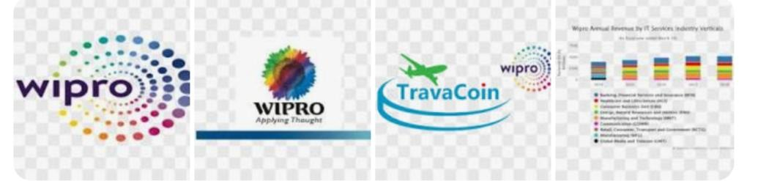

Slide 4
Brand study of wipro:
History and Background: Explore Wipro's history, including its founding, key milestones, and growth over the years.
Products and Services: Analyze the range of products and services Wipro offers. This includes IT services, consulting, outsourcing, and any specific industry verticals they focus on.
:

Slide 5
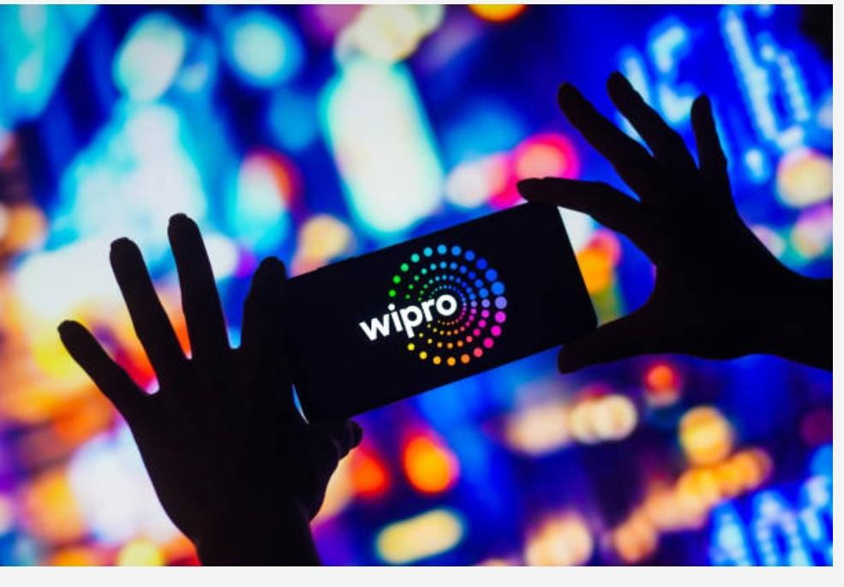

Slide 6
Competetor Analysis of Wipro:
Tata Consultancy Services (TCS): TCS is one of the largest IT services companies globally and a significant competitor to Wipro. Compare factors like revenue, market share, and service offerings.
Infosys: Infosys is another major Indian IT company that competes with Wipro. Analyze its strengths, weakn and market position in relation to Wipro.Cognizant: Cognizant is a U.S.-based IT services company known for its strong presence in various industries.

Slide 7
Mission and values of wipro:
Mission:
Wipro's mission is to be a leading global information technology company that helps clients achieve their business goals through innovative solutions and services.
Core Values:
Integrity: Wipro places a strong emphasis on integrity, honesty, and ethical conduct in all aspects of its business. They aim to build trust and credibility with clients, employees, and stakeholders.

Slide 8
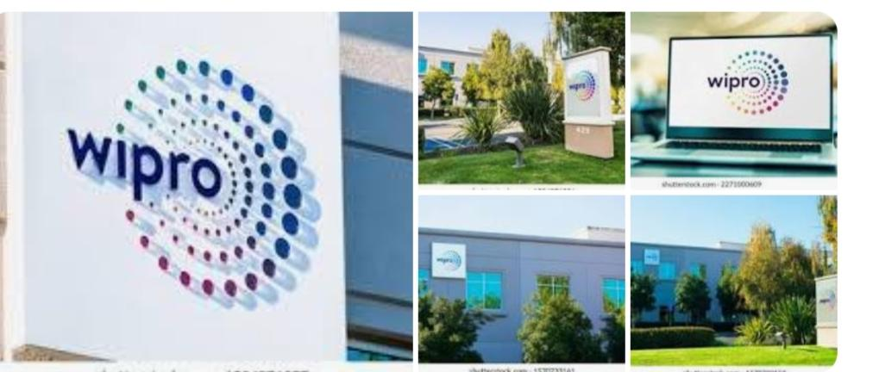

Slide 9
USP:
Wipro provides complete range of IT services to the organization

Slide 10
Analyse Brand Tone and Identity:
Brand Tone:
Professional and Trustworthy: Wipro maintains a professional and trustworthy brand tone. With a long history in the IT industry, it conveys a sense of reliability and expertis.
Identity:
Tagline: "Applying Thought" is its tagline, highlighting its commitment to innovative thinking and problem-solving.

Slide 11
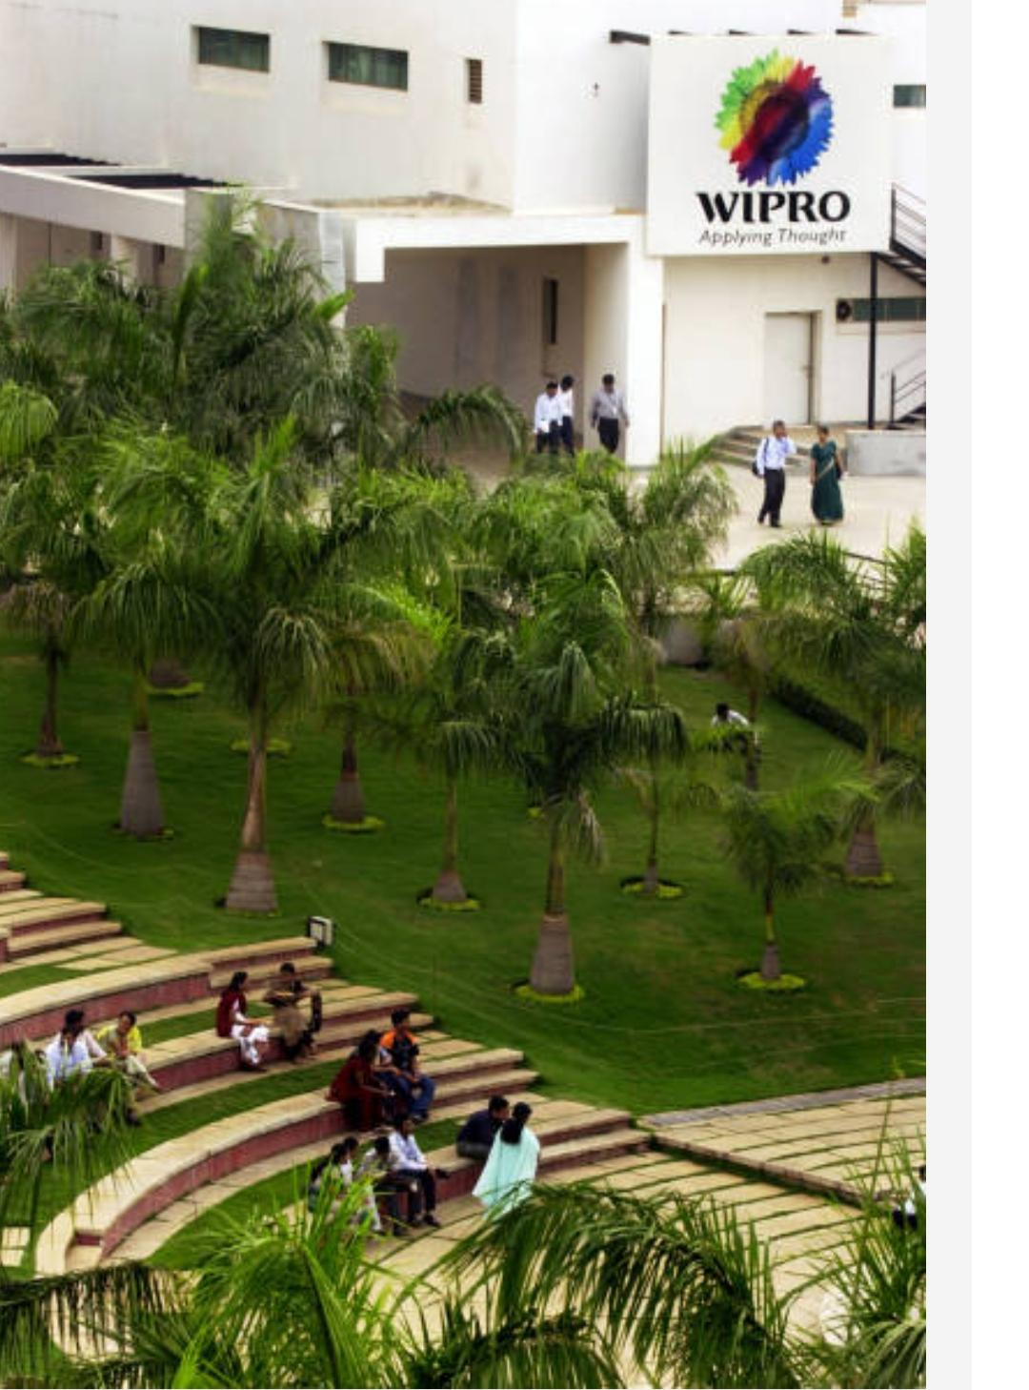
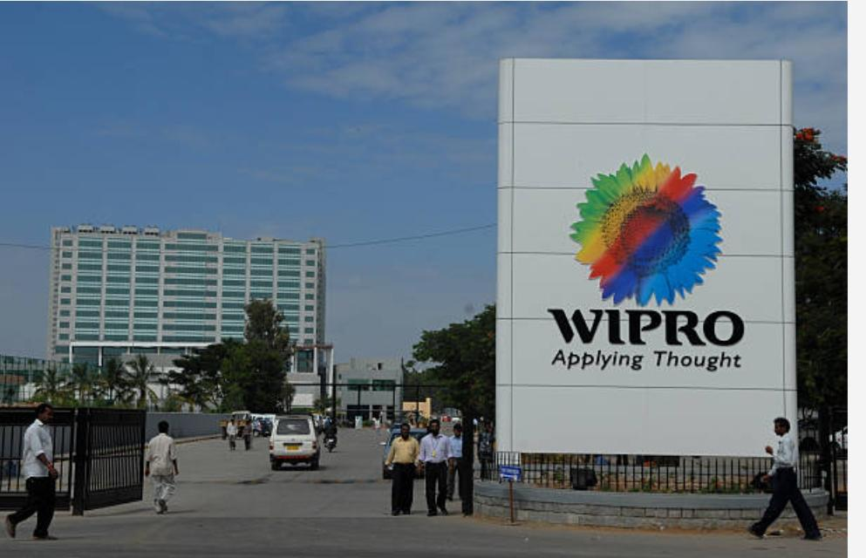

Slide 12
Set 5 smarts goals and KPIs for the same:
1. Goal: Increase Annual Revenue
Goal: Enhance Customer Satisfaction
Goal: Strengthen Employee Engagement
Enhance Environmental Sustainability
Goal: Expand Market Presence in Emerging Technologies.
Environmental Sustainability: "Reduce the carbon footprint by 15% through energy-efficient initiatives and sustainabilit.
KPI: Reduce carbon emissions by 15% compared to the previous year.
KPI: Increase the use of renewable energy sources to cover 40% of total energy consumption within the next two years.

Slide 13
Buyer's Persona:
Company Type: Wipro's buyer persona might include information about the type of companies they target, such as Fortune 500 companies, mid-sized enterprises, or startups.
Industry: Specify the industries that Wipro's clients belong to, such as healthcare, finance, retail, or technology.
Job Titles: Define the job titles of key decision-makers within the client organization, such as CIO (Chief Information Officer), CEO (Chief Executive Officer), or IT Directors.

Slide 14
Audiences Persona:
Chief Information Officer (CIO):
Job Role: The CIO is responsible for the overall technology strategy and IT operations within an organization.Goals: CIOs aim to improve IT efficiency, drive digital transformation, and ensure data security.Chief Executive Officer (CEO):
Job Role: CEOs are focused on the overall business strategy and growth.
Goals: CEOs seek to increase revenue…

Slide 15
Competetor 1:HCL Technologies:
HCL Technologies, like Wipro, is another Indian IT services company that provides IT consulting and outsourcing services.
Competetor 2:Capgemini:
Capgemini is a global consulting and IT services firm that competes with Wipro in providing consulting, technology, and outsourcing services.
Competetor 3:IBM:
IBM offers a wide range of IT services and solutions, including cloud services and artificial intelligence. It competes with Wipro in areas like cloud computing.

Slide 16
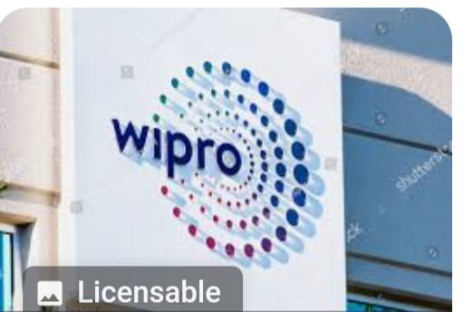


Slide 17
:SEO:
Search Engine Optimization (SEO) is crucial for any company, including Wipro, to improve its online visibility and drive organic traffic. Here are some key aspects of SEO that Wipro can focus on:
Keyword Research: Identify relevant keywords and phrases that potential clients might use to search for IT services, consulting,

Slide 18
: Keyword Research:
Keyword research is a critical component of SEO and digital marketing. To perform keyword research for Wipro, you'll want to identify relevant keywords and phrases that potential clients and visitors might use when searching for the services and solutions offered by Wipro.
Local Keywords: If Wipro serves specific geographic regions, consider including location-specific keywords, such as "IT services in [city or region].”

Slide 19
SEO AUDIT:
Content Quality:
Assess the quality and relevance of the content on the website. Ensure it provides value to users and is well-structured.
Mobile Optimization:
Verify that the website is mobile-friendly, as mobile optimization is essential for SEO.

Slide 20
: Define research objectives:
Research objectives for a company like Wipro, which operates in the IT services and consulting industry, can be diverse and tailored to specific initiatives or areas of focus. Client Needs Assessment:
Determine the evolving needs and challenges of Wipro's target clients.
Identify the most critical IT and business challenges clients are currently facing.
Explore potential gaps in service offerings.

Slide 21
Brainstorm seed keywords:
Information Technology
Outsourcing Services
Software Development
Digital Transformation
IT Consulting
IT Solutions
Business Process Outsourcing (BPO)
Artificial Intelligence
Cloud Computing
Cybersecurity
Data Analytics
Internet of Things (IoT)

Slide 22
Utilized keyword Research tools:
Wipro, being a global IT and consulting company, may use a variety of keyword research tools and techniques for their digital marketing and SEO strategies. These tools could include poppopular options like Google Keyword Planner, SEMrush, Ahrefs, Moz, and others.
For the most up-to-date information on the keyword research tools and strategies employed by Wipro, I would recommend visiting their official website, reviewing their digital marketing publications, or contacting their marketing or SEO teams for

Slide 23
Analyse competetor keywords:
However, you can use online tools like SEMrush, Ahrefs, or Google Keyword Planner to analyze competitor keywords for a company like Wipro. These tools can provide insights into the keywords your competitors are targeting in their online content and advertising

Slide 24
On-page optimization:
Keyword Research: Identify relevant keywords and phrases related to Wipro's services, products, and industry. Use tools like Google Keyword Planner to find valuable keywords.
Title Tags: Optimize the title tags of each page with the target keyword(s). Ensure the title is descriptive, concise, and appealing

Slide 25
Meta tag optimization:
Title Tag (Meta Title):
Keep it concise (around 60 characters) and relevant.
Include primary keywords or key phrases.Meta Description (Meta Description Tag):
Write a compelling description (around 160-320 characters).
Include relevant keywords naturally.
Encourage click-throughs with a clear value proposition.

Slide 26
Content optimization:
Content optimization is a critical aspect of improving the online visibility and user experience of Wipro's website. Here are steps and strategies to optimize content effectively
Keyword Research and Integration:
Perform keyword research to identify relevant keywords and phrases.
Integrate these keywords naturally into the content, including headings, subheadings, and body text.Optimize Meta Titles and Descriptions:
Craft compelling meta titles and descriptions that include target keywords.

Slide 27
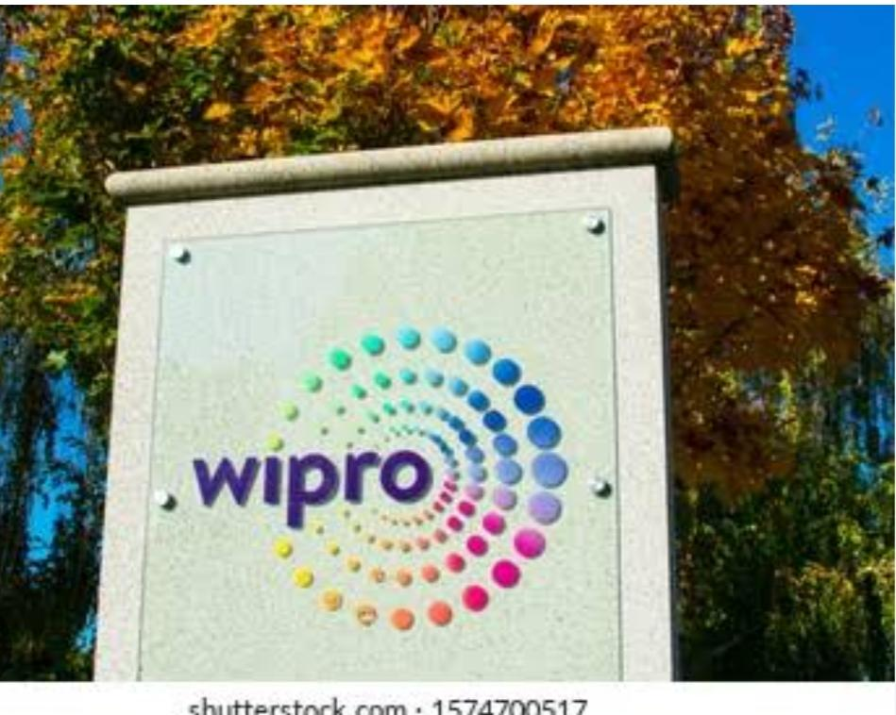
Content ideas and marketing strategies:

Slide 28
Content ideas and marketing strategies:
Wipro is a global IT services and consulting company. To create content and marketing strategies for Wipro, consider these ideas:
Thought Leadership: Publish whitepapers, blog posts, and videos on emerging technology trends, industry insights, and best practices in IT and consulting.Case Studies: Showcase successful client projects and the impact of Wipro's services.
Webinars: Host webinars on topics relevant to Wipro's services, inviting industry experts as speakers.

Slide 29
:Content ideas generation:
Generating content ideas for Wipro can help keep their marketing efforts fresh and engaging. Here are some content ideas:Explainer Videos: Create short videos explaining complex IT concepts or solutions in a simple and engaging way.
Client Success Stories: Share in-depth case studies highlighting how Wipro's services have transformed clients' businesses.

Slide 30
:content strategy:
Understand Your Audience:
Create detailed buyer personas to understand the needs, challenges, and preferences of your target audience. This will help tailor your content to their specific interests.
Content Types:
Diversify your content mix to cater to different preferences. This could include blog posts, whitepapers, case studies, videos, infographics, webinars, podcasts, and more.

Slide 31
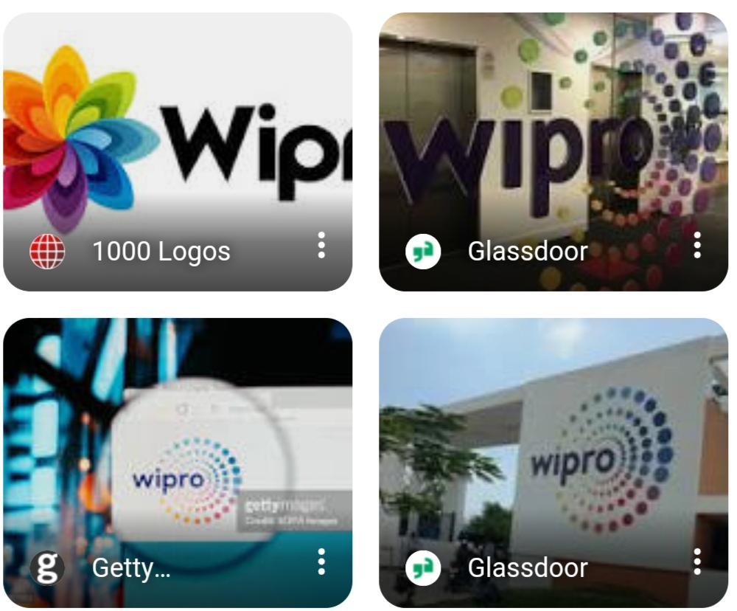

Slide 32
Content creation and curation :
Understanding the Brand: Begin by understanding Wipro's brand, its values, mission, and target audience.
Content Strategy: Develop a content strategy that aligns with Wipro's goals. This may involve creating content for different stages of the buyer's journey.
Curation:
Content Curation: Share industry news and insights from reputable sources, adding your own commentary to engage the audience.

Slide 33
Instagram story:
Instagram story about Wipro.
Instagram profile link:
https://instagram.com/prems_business?igshid=OGQ5ZDc2ODk2ZA==
Instagram story link:
https://www.instagram.com/reel/CycUyVrxier/?igshid=MzRlODBiNWFlZA==
Instagram highlight link:
https://www.instagram.com/s/aGlnaGxpZ2h0OjE4MDk5NDI2MjUzMzU1OTQ4?story_media_id=3214534863092998891_62257702397&igshid=MzRlODBiNWFlZA==

Slide 34
Roles:
G.prameela__introduction and Teamleader
A.sravanthi__infomation aboutUSP
b.jayanthisri__information about SEO
B.priyanaka__information aboutCONTENT STRATEGY
Ch.padma__inforamation aboutON PAGE CONTENT OPTIMIZATION

